Slide 1

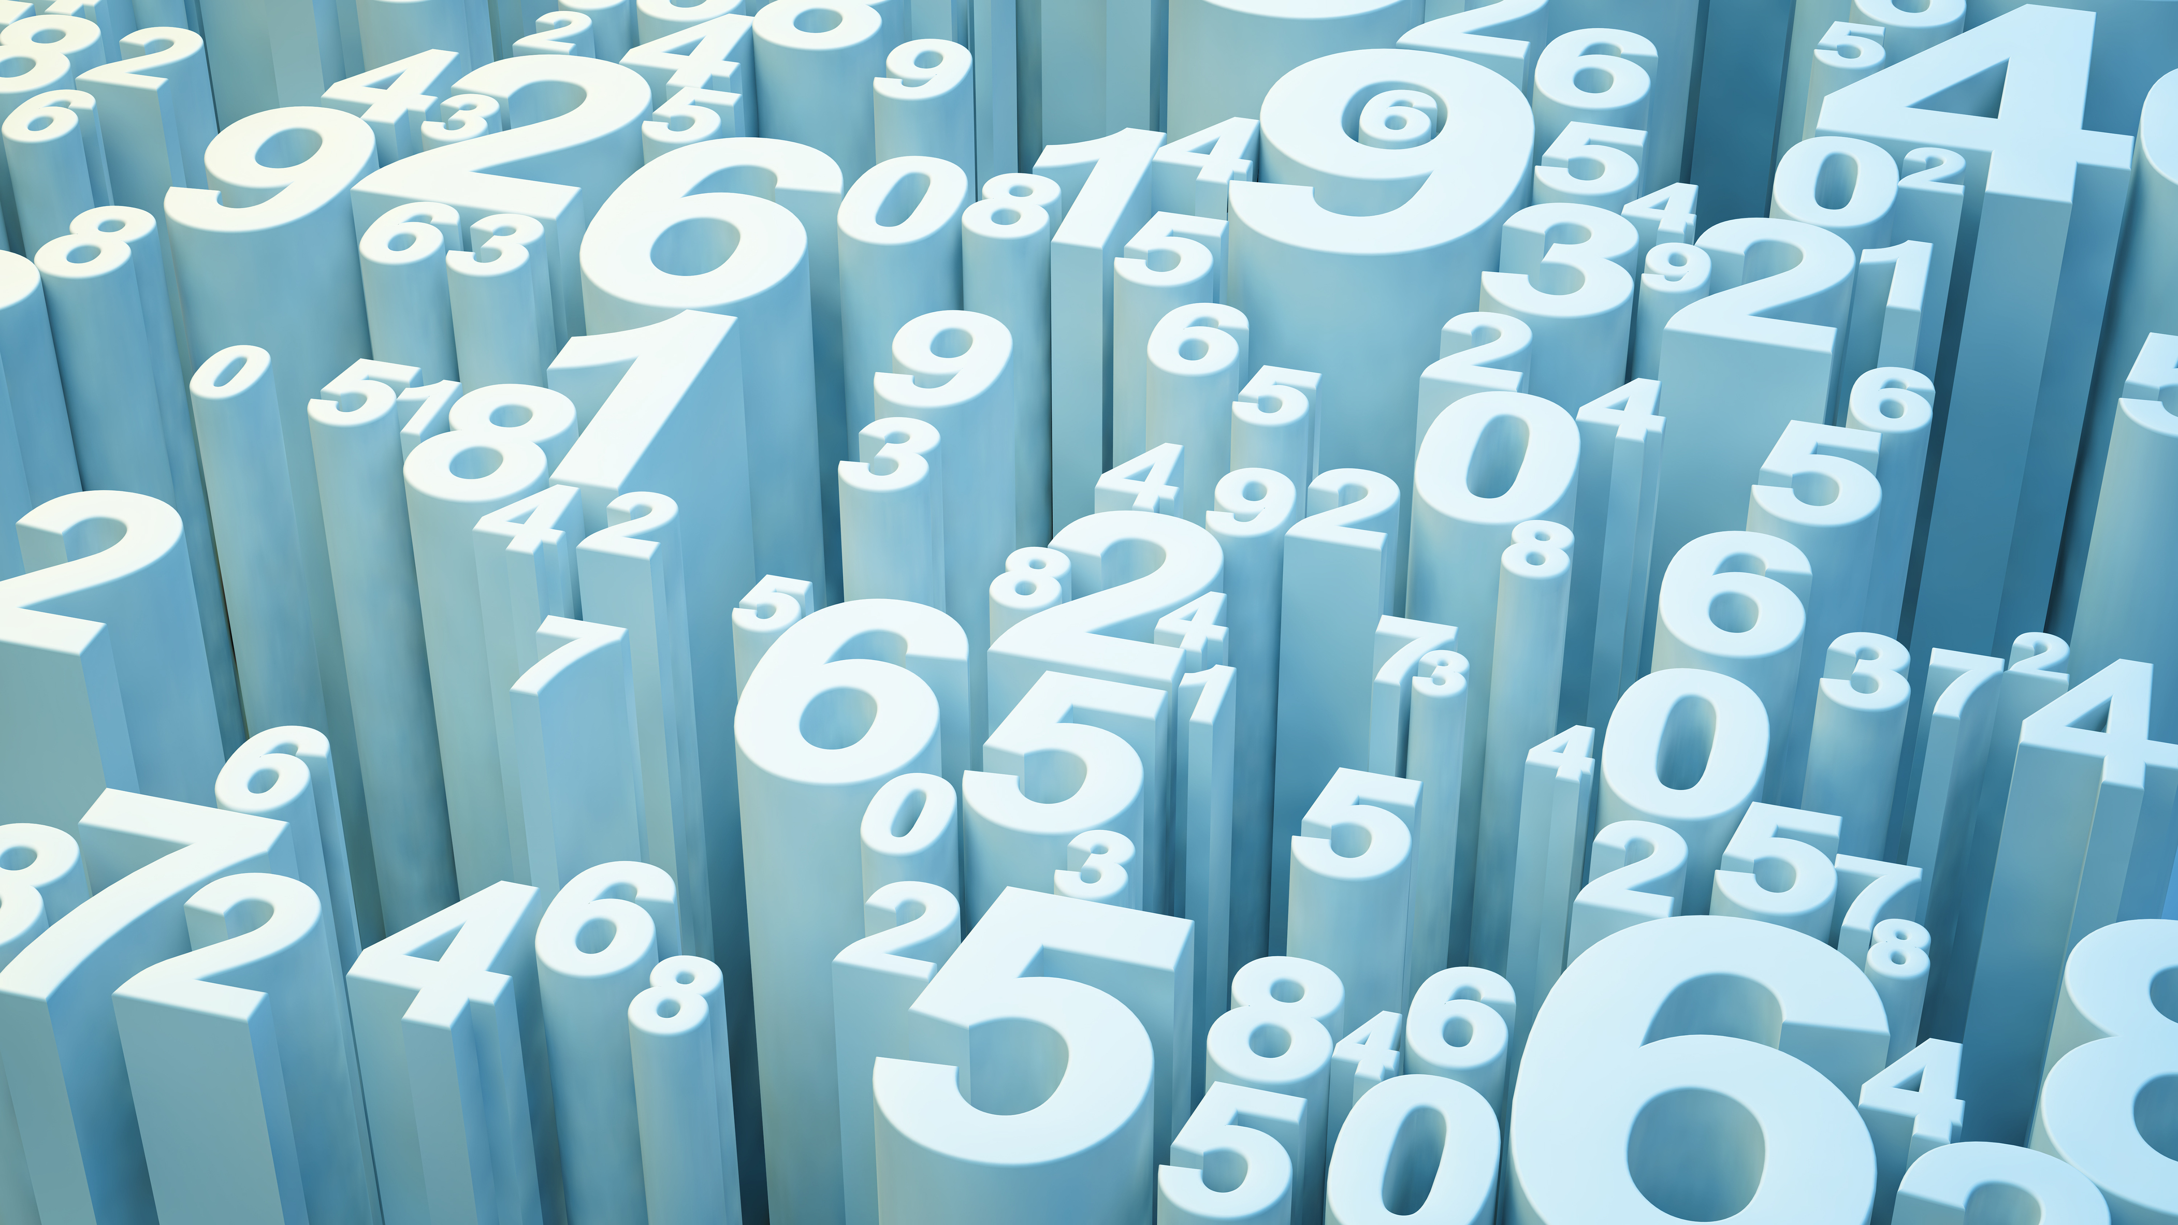
Ethics in Data Science
Discussion on Ethical Considerations, Data Privacy, and Responsible Data Use
Compiled and Presented
By
Alli M.J

Slide 2
INTRODUCTION
What is Ethics in Data Science?

Slide 3
Ethics in Data Science
Ethics in Data Science refers to the principles guiding the responsible use of data and algorithms, ensuring that outcomes are fair, transparent, and respect individuals' rights.
Importance: As data-driven decision-making becomes more prevalent, ethical considerations are critical to prevent harm, bias, and misuse of information.
Overview: This presentation will cover key topics including ethical considerations, data privacy, and the principles of responsible data use.

Slide 4
Importance of Ethics in Data Science
Why Ethics Matter

Slide 5
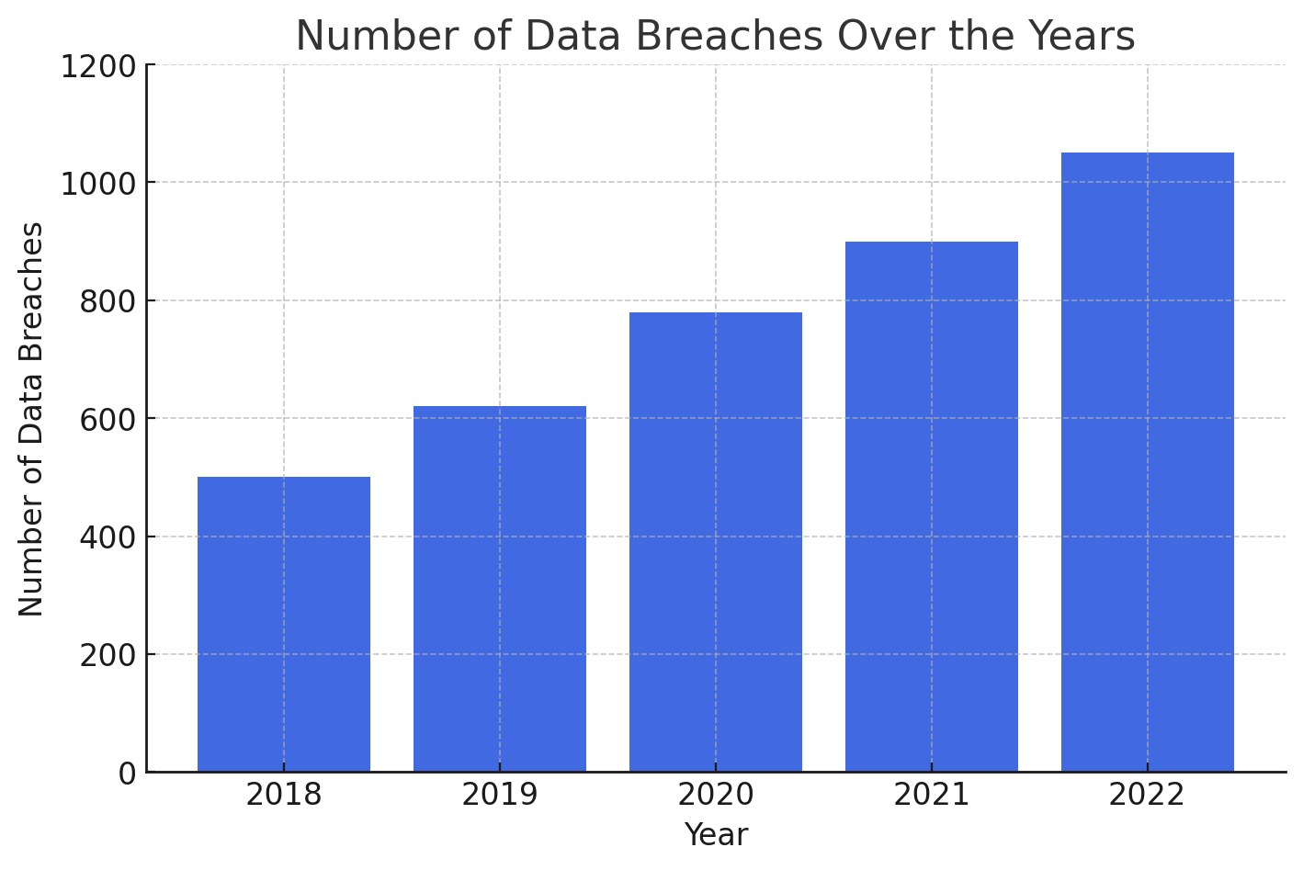
Impact of Unethical Practices: Unethical data use can lead to privacy violations, discrimination, and loss of public trust. Examples include biased algorithms in hiring or predictive policing. Trust and Credibility: Upholding ethical standards ensures that data science practices are respected and trusted by the public and stakeholders.
Case Examples:
Cambridge Analytica: Misuse of data for political manipulation.
Facial Recognition Technology: Bias in recognition rates across different demographic groups.

Slide 6
Ethical Considerations
Key Ethical Considerations

Slide 7
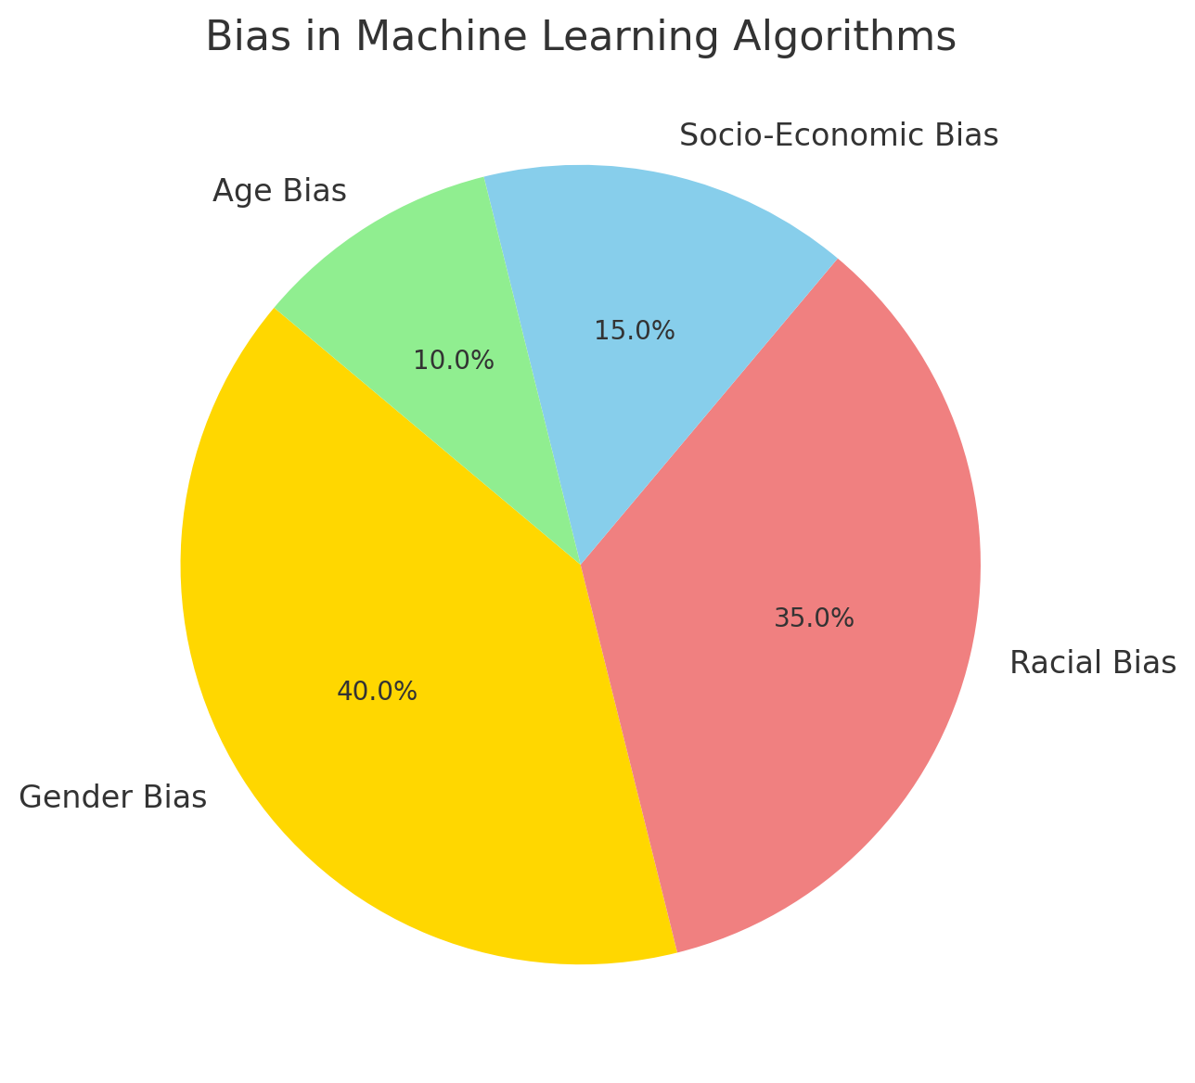
Bias and Fairness: Algorithms must be designed to avoid perpetuating biases present in data. Example: Ensuring that machine learning models are trained on diverse and representative datasets. Transparency: Data scientists should clearly communicate the methods and data used in analysis. Open-source data and models where possible to promote accountability.
Accountability:
Organizations should be accountable for the outcomes of data-driven decisions.
Mechanisms should be in place to address errors or harm caused by these decisions.

Slide 8
Data Privacy
Protecting Data Privacy

Slide 9
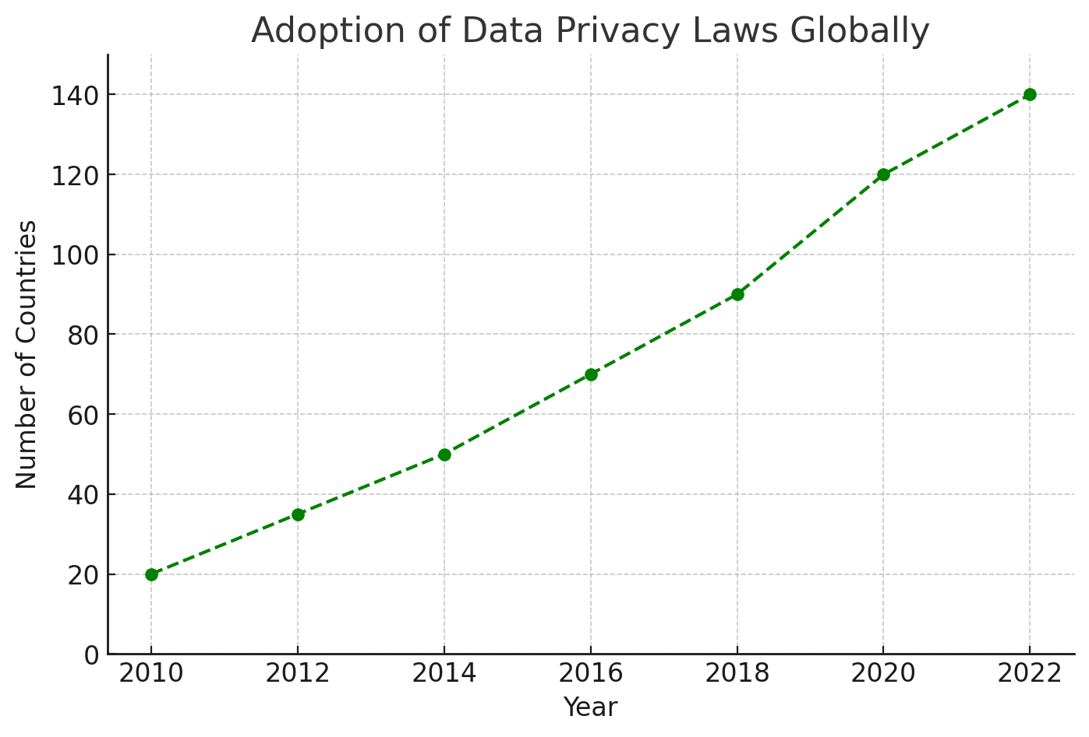
Data Privacy Laws: Overview of regulations like GDPR (General Data Protection Regulation) and CCPA (California Consumer Privacy Act) that set standards for data protection. Anonymization and Encryption: Techniques to protect individual privacy while allowing data analysis.
Balancing Utility and Privacy: Ensuring that data remains useful for analysis while respecting privacy.
User Consent:
Importance of obtaining informed consent from individuals before collecting or using their data.

Slide 10
Conclusion
Challenges and Solutions
Common Challenges:
Difficulty in identifying and mitigating bias in complex algorithms.
Balancing innovation with privacy and ethical considerations.
Solutions:
Establishing ethical review boards to evaluate data science projects.
Developing and adhering to ethical frameworks, such as the Fairness, Accountability, and Transparency in Machine Learning (FAT/ML) principles.
Continuous education and training on ethical issues for data scientists.
Guidelines for Ethical Data Science
Adopting a Code of Ethics: Following established codes like the ACM Code of Ethics, which provide a framework for ethical decision-making.
Regular Assessment: Regularly reviewing and updating ethical practices to reflect new challenges and advancements in the field.
Diverse Teams: Collaboration with diverse teams helps ensure that different perspectives are considered, reducing the risk of bias.
Stakeholder Engagement: Engage with stakeholders, including those who might be affected by data-driven decisions, to understand their concerns and perspectives.

Slide 11
Refrences
1. General Data Protection Regulation (GDPR). (2018). Retrieved from https://gdpr.eu
This is a comprehensive regulation on data protection and privacy in the European Union.
2. ACM Code of Ethics and Professional Conduct. (2018). Association for Computing Machinery. Retrieved from https://www.acm.org/code-of-ethics
A set of ethical guidelines for professionals in computing and data science.
3. FAT/ML: Fairness, Accountability, and Transparency in Machine Learning. (2020). Retrieved from https://www.fatml.org
Principles and resources for ensuring fairness, accountability, and transparency in machine learning and data science.
Facial Recognition Technology and Bias. (2020). National Institute of Standards and Technology Retrieved from https://www.nist.gov/news-events/news/2020/12/nist-study-evaluates-effects-race-sex-age-face-recognition-software
A study examining bias in facial recognition technology across different demographic groups.
4. Data Science and Ethics: An Introduction for Practitioners. (2020). Data & Society Research Institute. Retrieved from https://datasociety.net/library/data-science-and-ethics-an-introduction-for-practitioners/
A resource providing an introduction to ethical issues in data science.

Slide 12
Thank You

